Slide 1
Department of Computer Science & Engineering
UE17CS355 – Web Tech II Laboratory
Project Evaluation
Project Title : MOOC Listing Website
Project Team : PES1201701256 – Sarvesh Kedia
PES1201701244 – Lamya Bhasin
PES1201700272 – Pratik Bhyatnal

Slide 2
Project Description
Project Description
Our projects lists out various online courses available on website like udemy, coursera, edx etc. with all their details. So the user can browse courses from various website at one place.
If the user likes a course, they can add it to their wishlist or they can visit the website where the course is hosted on to purchase it.
Based on what courses you add to your wishlist, user will be shown recommendations to what other courses they might find interesting.
We show statistics on the most popular courses. Which is dynamically updated when someone adds a course to their wishlist.
User can also see an RSS feed on information about latest online courses and remote learning.

Slide 3
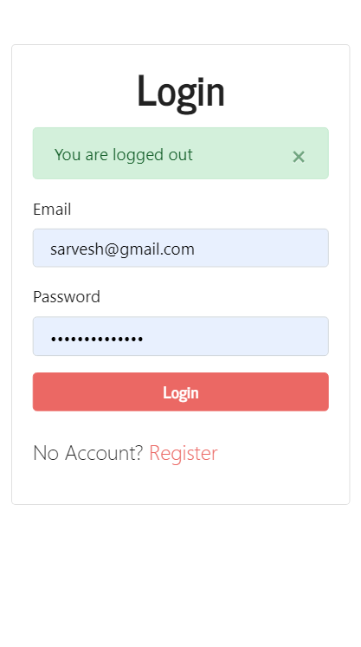
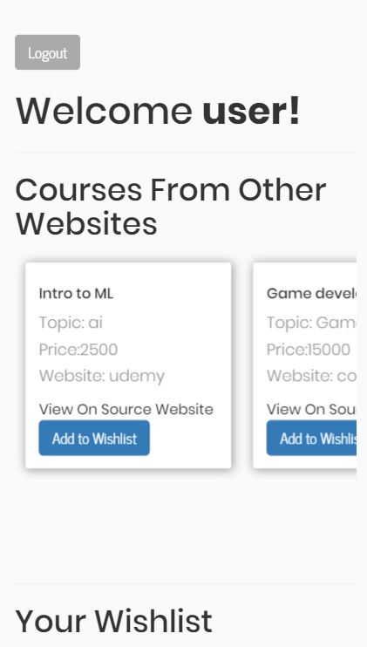
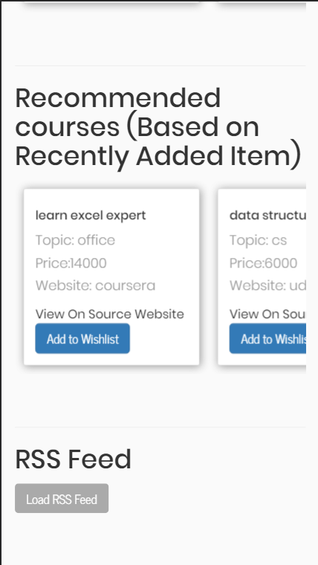
Project Description
Project Description

Slide 4
Project Description
Technologies Used
Languages:
HTML/ CSS/ Javascript
Node.JS
Frameworks:
Express (Backend)
Jquery (Frontend)
Database:
Mongo DB

Slide 5
Project Description
Technologies Used
Libraries:
Bootstrap
Axios
Ejs
Mongoose
Middleware:
Passport JS
Body Parser
Project Structure:
MVC model

Slide 6

Project Description
RSS Implementation
We used the following rss feed - https://www.edsurge.com/articles_rss
We used iframe to to display our rss feed within the wepage
From the front end we made a call to a back end api. In the backend, we parsed the xml to json notation and passed it to the front end.
In the front end we extracted the relevant information out of the parsed data and displayed it on the web page.
We also used EJS – templating engine to help display the data in an efficient and easy way.

Slide 7
Project Description
REST Implementation
We used Express JS framework along with node js to handle all our routes.
We have multiple api end point in the backend to handle various html request like get post, update. These apis are called by the front end, to get relevant data or to push data onto the database in the server.
Authentication and authorization happens also through a such apis.
We maintain stateleslessness and have set up an infrastructure where its easy for the front end to communicate with the back end
We used axios library that abstracts ajax to make it easy for us to handle our api calls asynchronously.

Slide 8
Project Description
Intelligence and Data Analytics
Every time a user adds something to their wish list, we send them other courses that they might be interested in. we determine this by finding all users who have that same course in their respective wish lists and recommend other course from their wish lists to the user.
We also show an animated graph of the most popular courses on our website. We find out the occurrence of all courses across all wish lists of the users and display graph accordingly. This graph also dynamically gets updated with every update to the wish list.

Slide 9
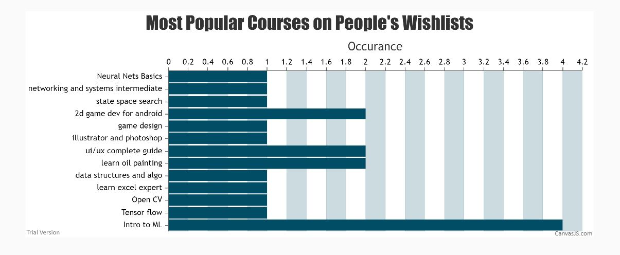
Project Description
Intelligence and Data Analytics

Slide 10
Thank You

